Slide 1
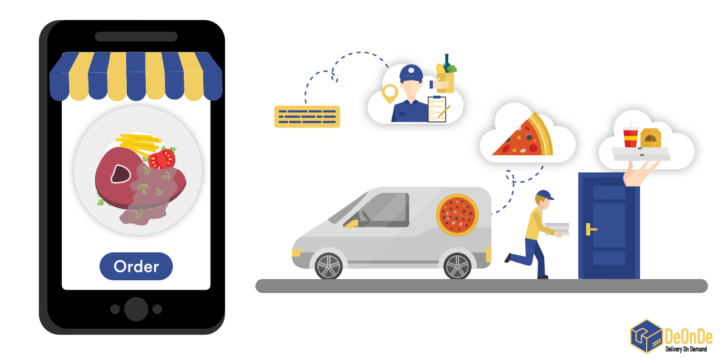
SNACKS CENTRE ONLINE DELIVERY SYSTEM
By:
Goddumarri Vanitha
Devi Reddy Guru Shilpa
Srirama Sravya
Malleswari Gajjala
Nallabothu Nandhini Guided by: -
Aliasger Mulla

Slide 2
CONTENTS COVERED
01
02
03
05
06
04
INTRODUCTION
Purpose
Data Flow Diagram
Non-Functional Requriments
Functions
Applications
07
Challenges Faced
08
Conculsion

Slide 3
Introduction :
Aim:-
The aim of this document is to Snacks center online delivery system,without going anywhere.
Snacks for Text Files application is provided in this document.
Intended Audience: -This application is intended to be use by, Client.
Intended Use:
Development Team
Maintenance Team
Clients

Slide 4
Purpose
Time-Saving
The best thing about this application is it help users to produce an error free result within a few seconds.
Easily Accessible
This application is compatible with almost every smart device having an internet connection.
No Installation required
This application don’t require any installation process and provides the best options for editing tasks

Slide 5
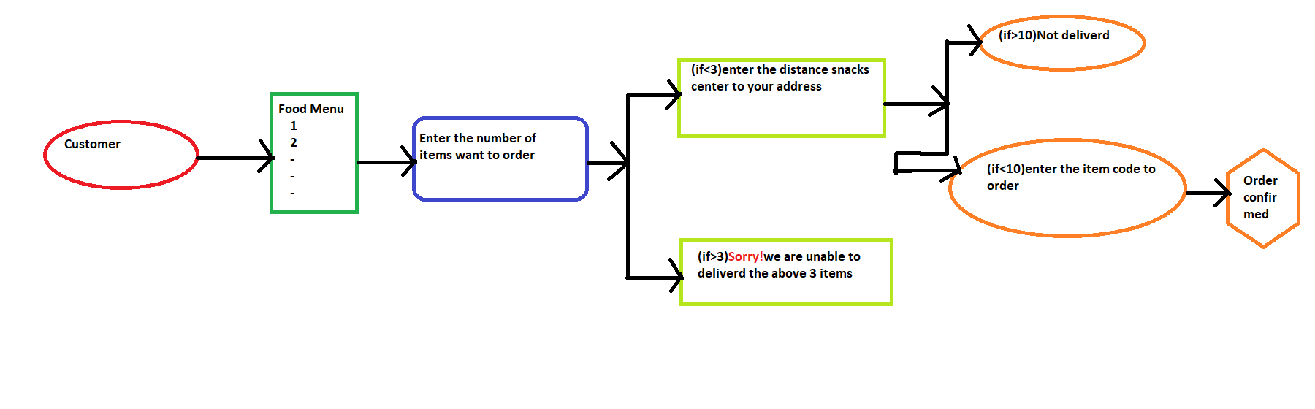
Data Flow Diagram
DFD Level 0

Slide 6
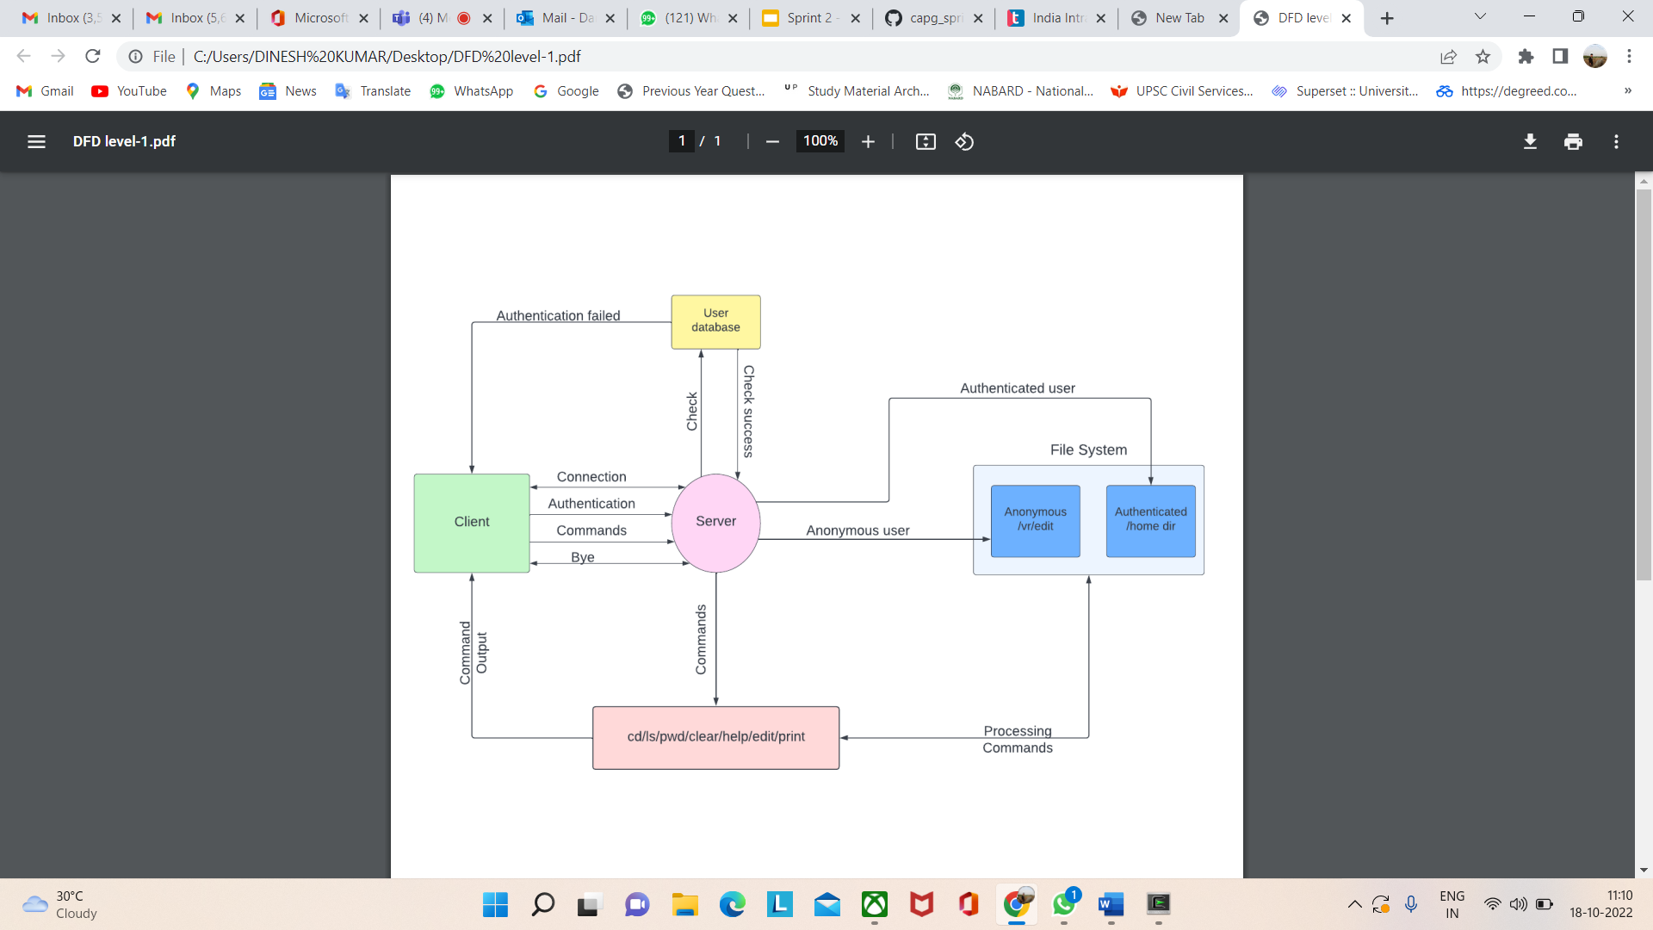
DFD Level 1

Slide 7
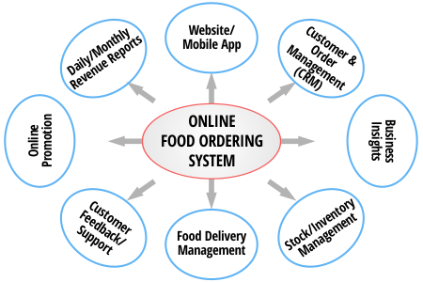

Slide 8
Structure
Typedef Struct food
{
Int price,item_code;
Char food_item[max]
}food;
Typedef struct order
{
char name[max];
int qty,item_code;
struct order *link;
}orders;

Slide 9
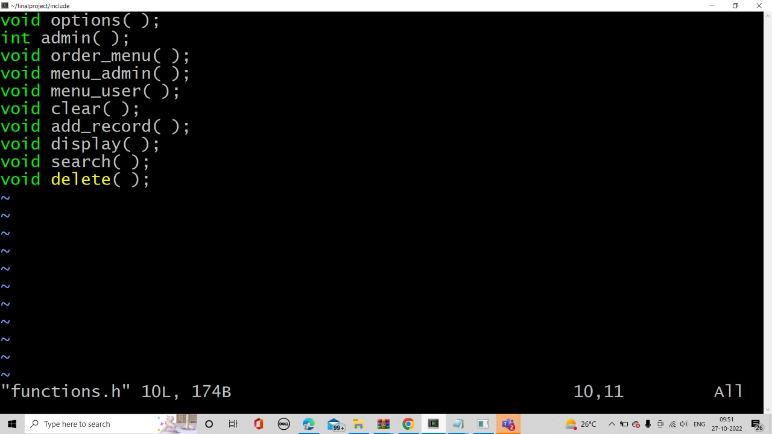
List of Functions

Slide 10
Non-Functional Requirements
Makefile Link:- C:/cygwin64/home/DELL/finalproject/make
Tools to be used
Makefile:- It is a way of automating software building procedure and other complex tasks with dependencies.
It is a set of commands with variable names and targets to create object file and to remove them.

Slide 11
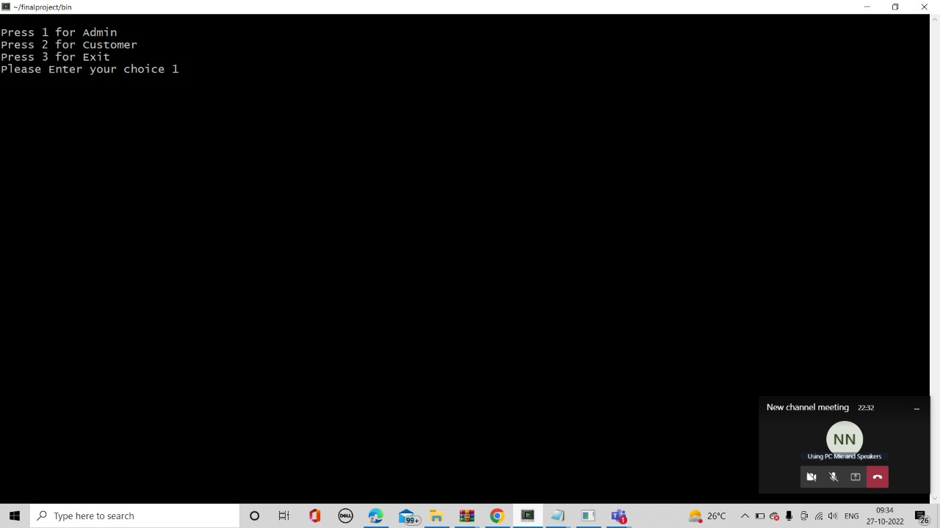
output

Slide 12
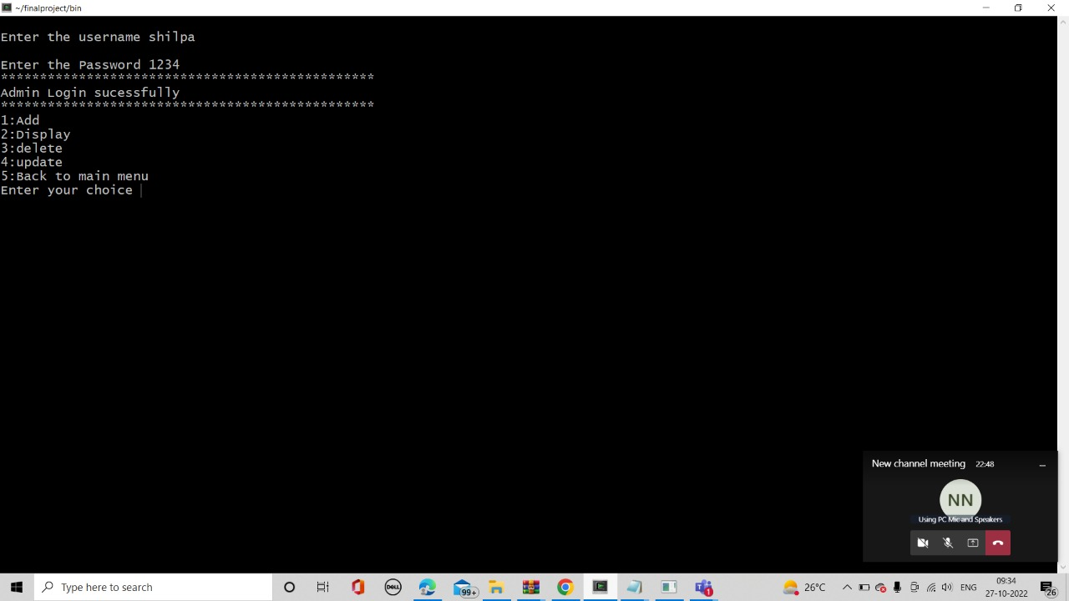

Slide 13
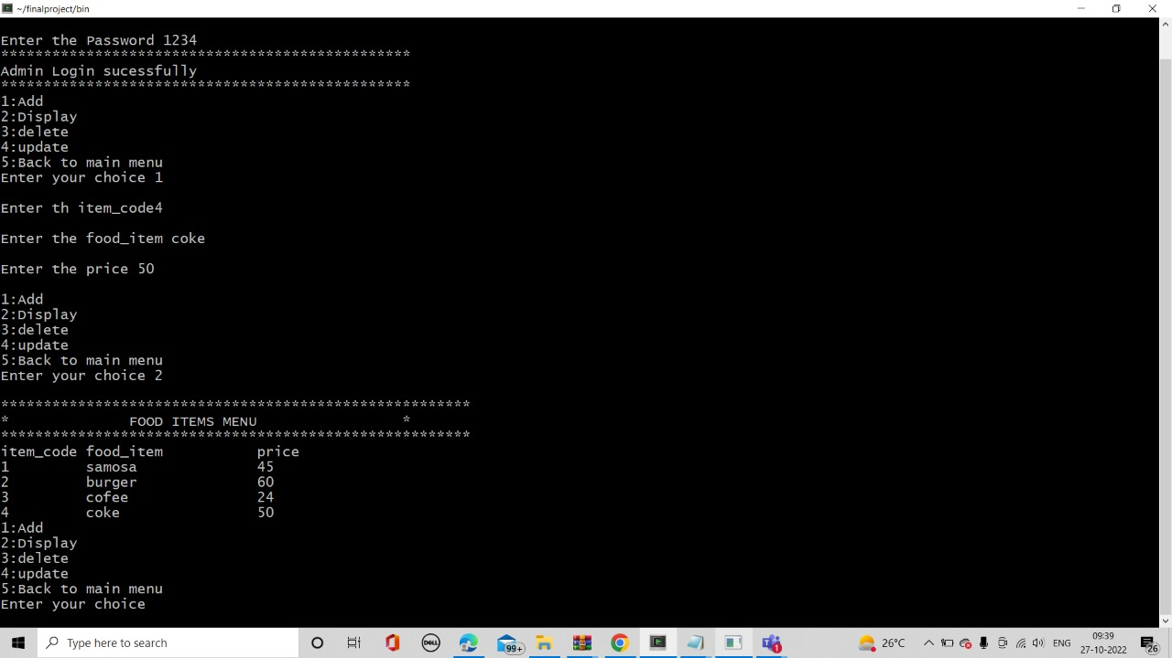
Add and display File

Slide 14
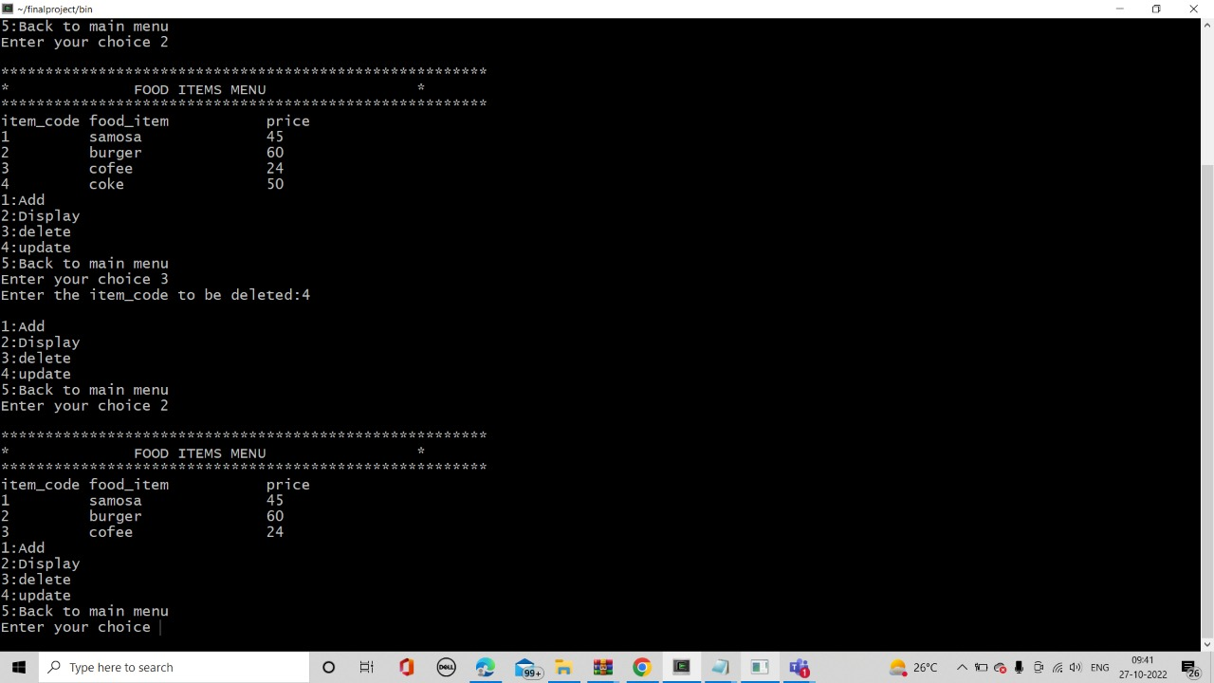
Delete file

Slide 15
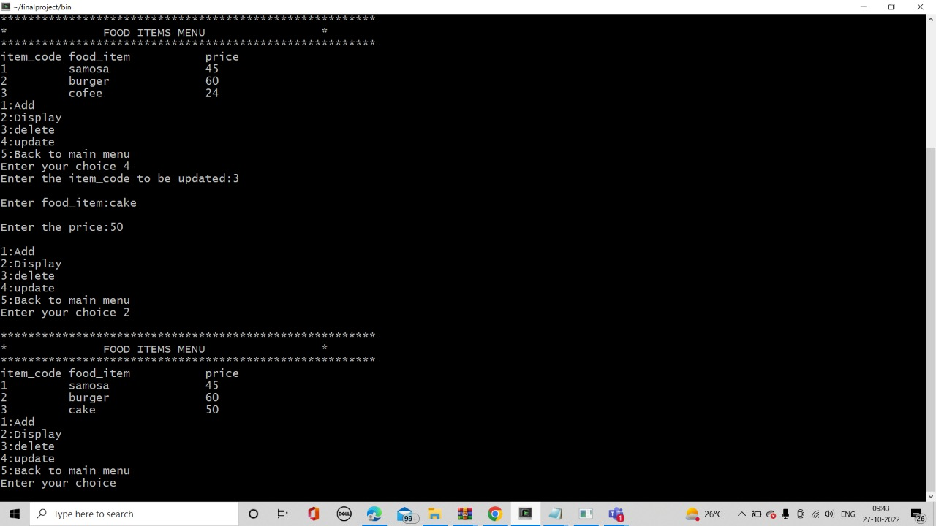
Update the functions file

Slide 16
Advantages
Makes the ordering process easier
The convenience of mobile ordering
Free and cheap marketing
Efficient customer and order management

Slide 17
Challenges Faced
Choosing appropriate structures
Satisfying all the requirements
Constantly improvising the code
Handling errors

Slide 18
Conclusion
`
The purpose of this application was to identify effective strategy of editing text files by multiple users in less time from any device having internet connection without any installation.

Slide 19
Github Link:- https://github.com/projectgrup6/online-snacks-delivary-system

Slide 20
THANK YOU

